Slide 1
Mobile Computing Laboratory CSE 3218
Project Title: Daily Recipes
Presented By:
Abu Buckker Siddiq Labib (1907108)
Md Sumon Hossain (1907109)
Wasif Zahin (1907112)
Biduyt Das (1907118)
Doniel Tripura (1907121)

Slide 2
Objectives
To learn about Swift & SwiftUI for iOS development.
To learn about Mobile Application Development using Swift.
To be familiarized with User Experience (UX) & User Interface (UI) Design.
To learn about Xcode storyboard and interface builder.
To be familiarized with & Implementation of Database & Json parsing using swift.

Slide 3
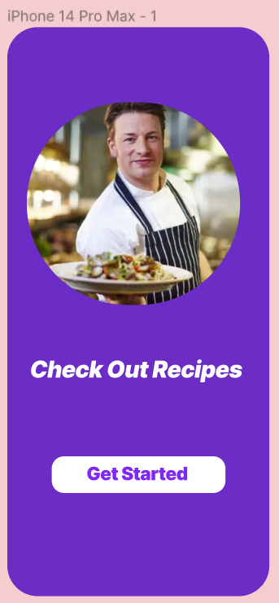
Introduction
Are you tired of the endless search for the perfect recipe and the hassle of organizing your culinary creations?
Look no further! ‘Daily Recipes’ is here to revolutionize your cooking experience. Whether you're a house chef or a cooking expert, this app is designed to make your life easier in the kitchen.

Slide 4
Features
Discover interesting recipes.
Explore recipes by Cuisine.
Add recipes to your favorite list.
Rate recipes.
Share your mouthwatering recipes.
Rank chef by rating.

Slide 5
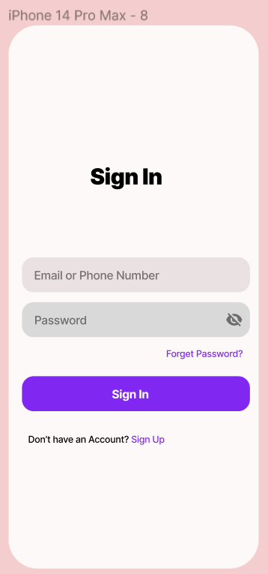
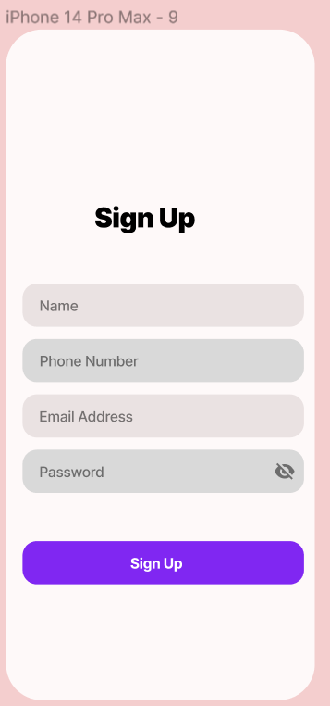
Sign in & Sign Up
User can sign in using email/phone number and password.
Recover password if forgotten.
User can sign up providing phone no and email.
User information is stored in database.

Slide 6
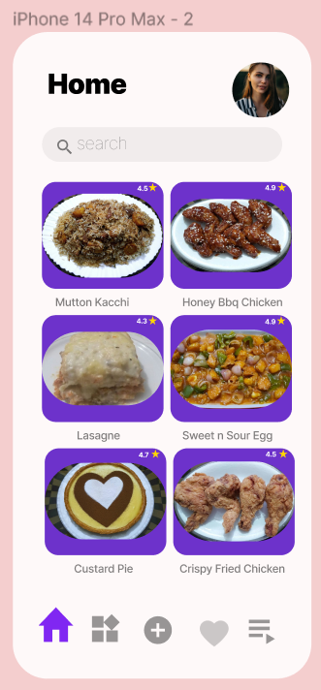
Home Page
Here many delicious recipes are provided.
One can search his/her favorite recipes.

Slide 7
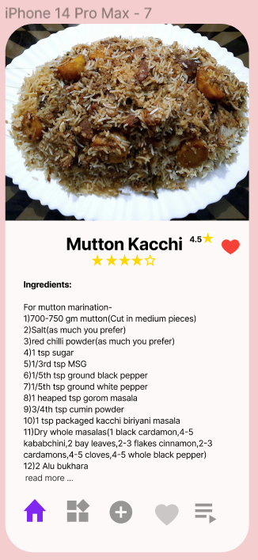
Detailed Recipe
Here, recipe is provided with ingredients name, amount and step by step process.
One can rate the recipe out of 5 star.
One can add the recipe in his/her favorite list.

Slide 8
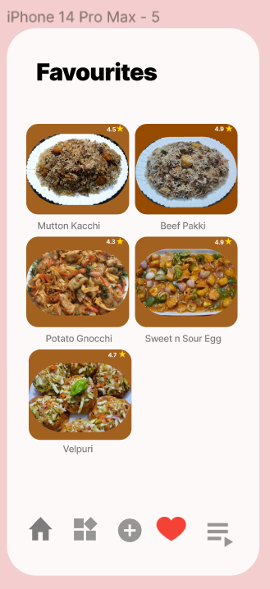
Check your Favorite Recipe
Find your favorite recipes here.

Slide 9
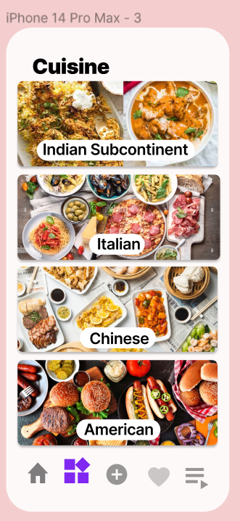
Category of Cuisine
Here recipes are divided into multiple cuisine.
One can find recipes of his/her desired cuisine.

Slide 10
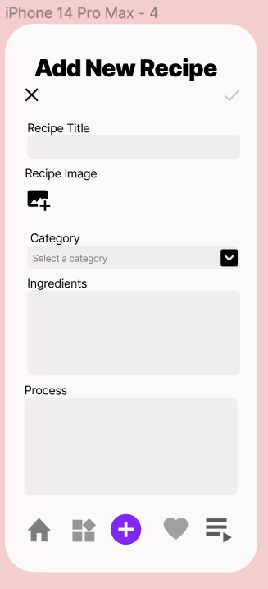
Add New Recipe
One can share his/her own recipe with others.

Slide 11
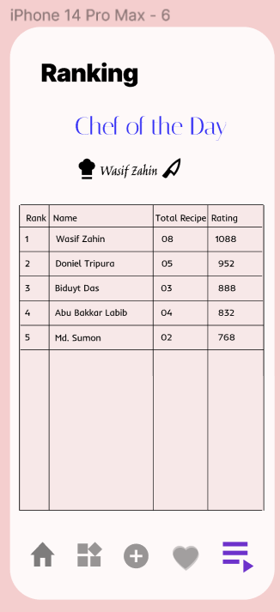
Check Out Ranking
Check out your ranking.
Meet the chef of the day!
Chef rating= k*(0.8*Avg Rating of recipes+0.2*No of Total Recipe)
K= chef constant=200

Slide 12
Thank You

